Slide 1
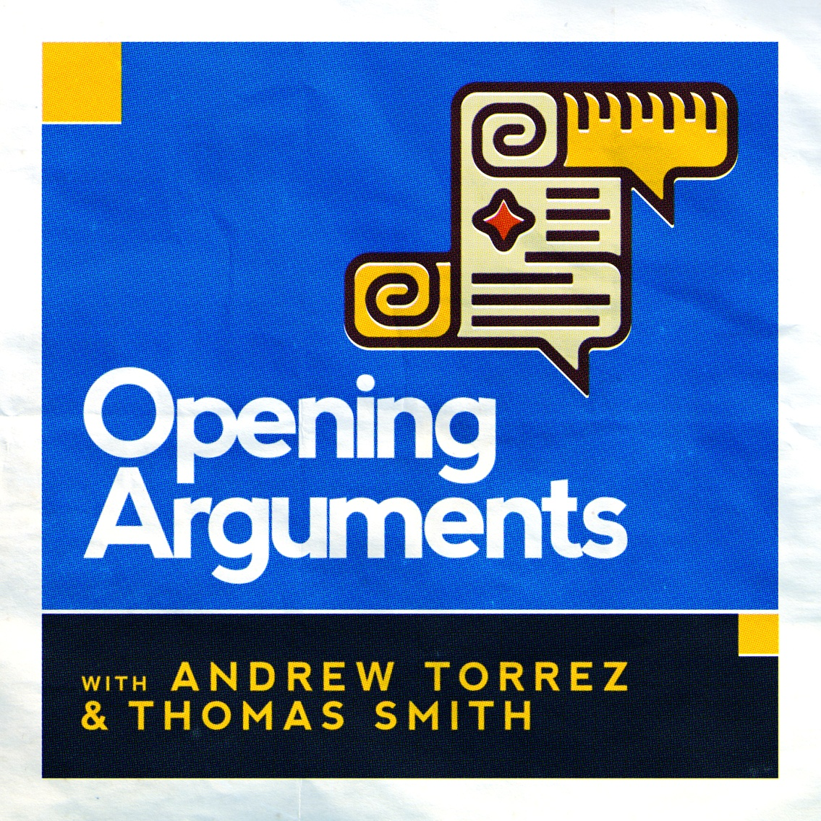
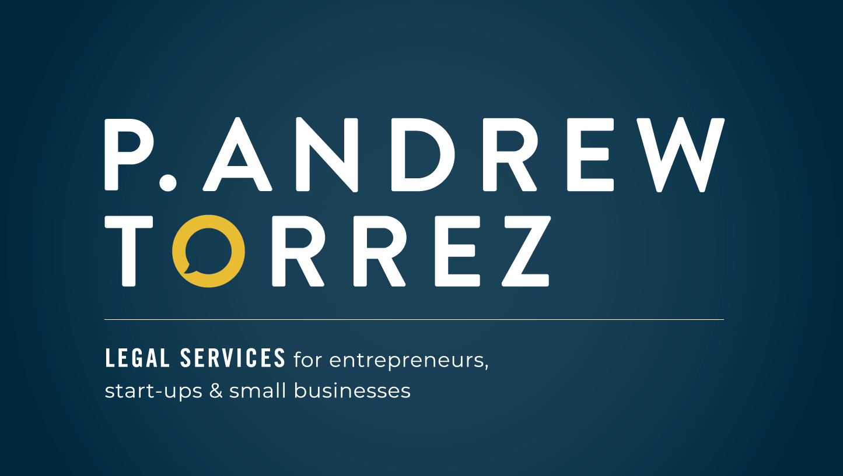
A Retrospective on the Supreme Court’s 2022 Spring Term
www.patorrez.com

Slide 2
The Supreme Court Hates You (Yes You!) Personally & What (Little) You Can Do About It
www.patorrez.com

Slide 3
DISCLAIMERS
Houston Freethought OASIS is a 501(c)(3) nonprofit educational organization and nothing in this speech is, or is intended to, advocate on behalf of or in opposition to any political campaign or any candidate for public office.
Nothing in this speech constitutes legal advice or creates an attorney-client relationship.
Don’t take legal advice from this speech!

Slide 4
PART I

Slide 5
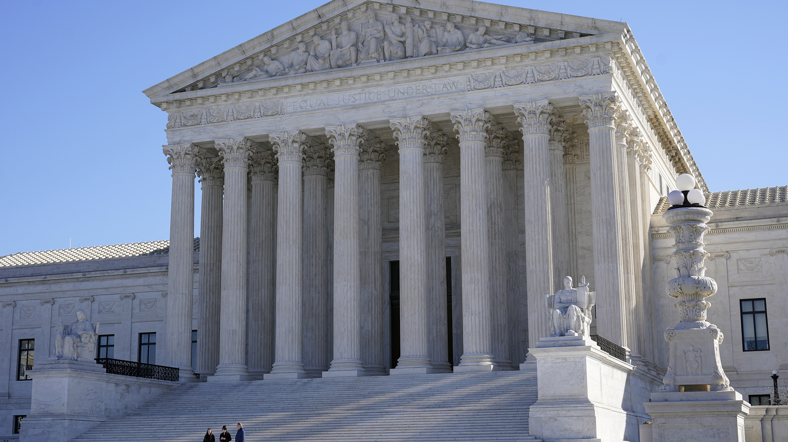

Slide 6
“that august body”

Slide 7
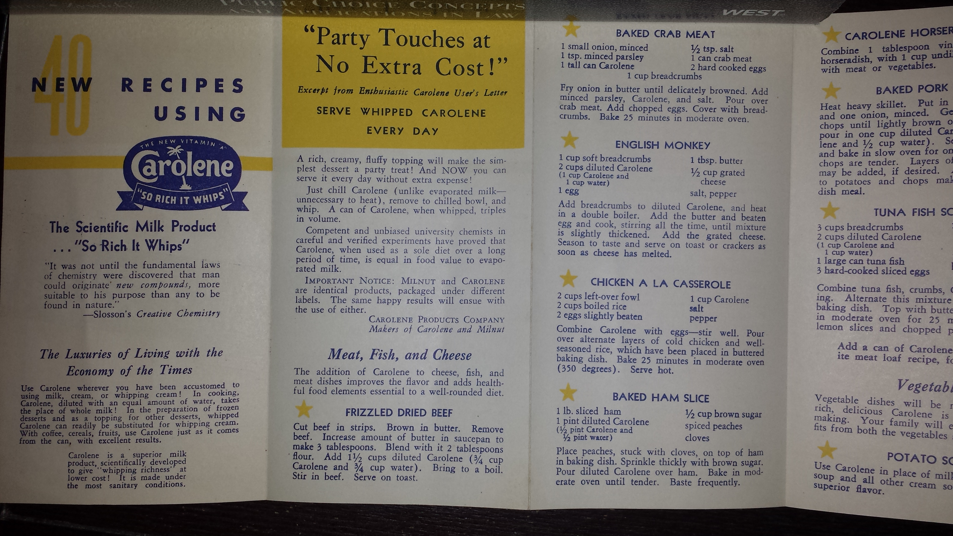
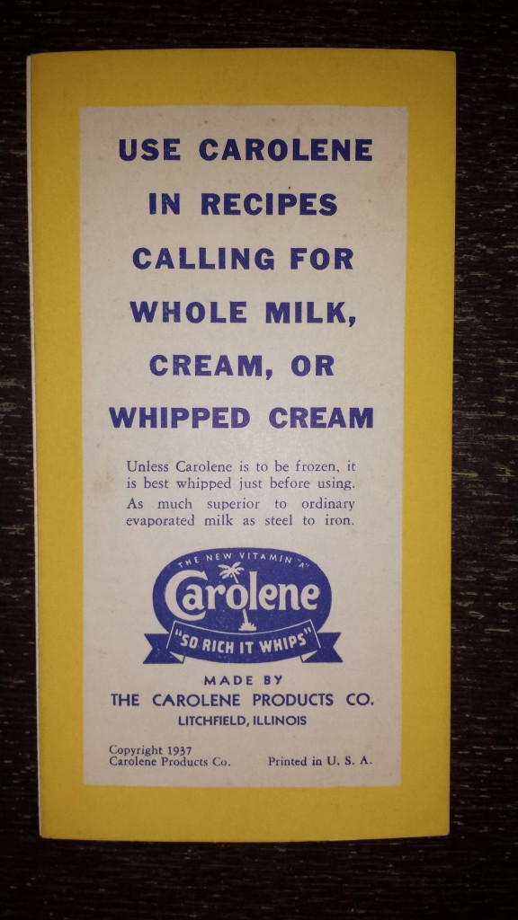
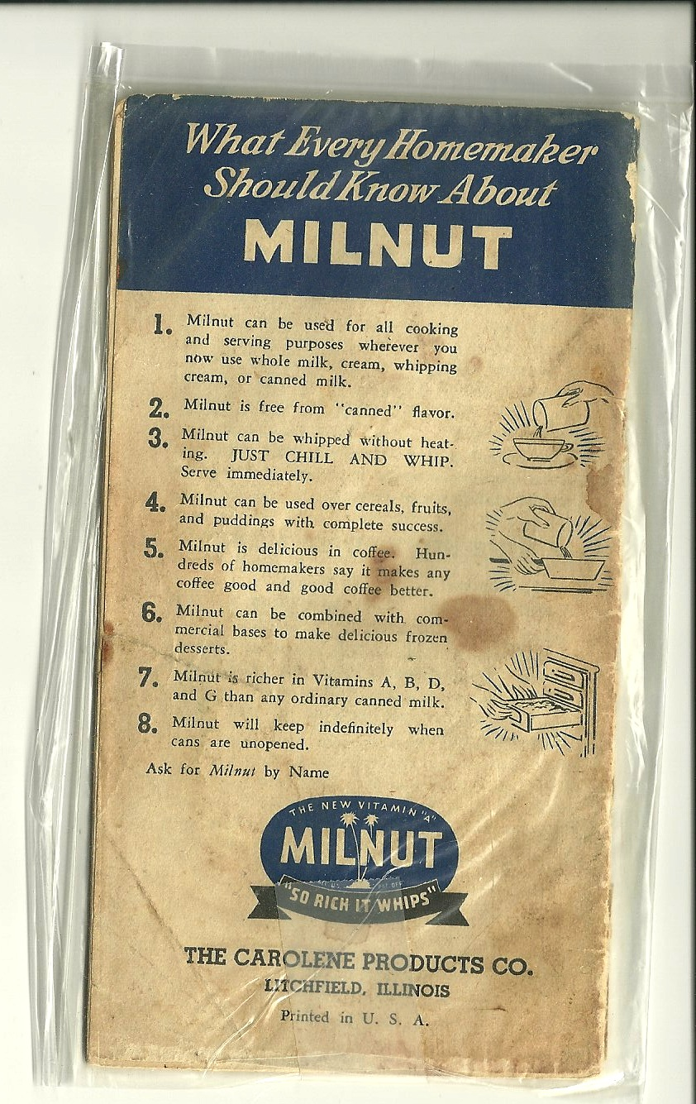
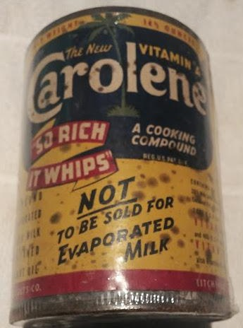

Slide 9
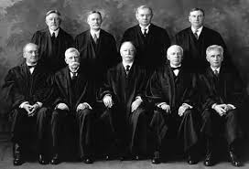
“Lochner”
Era
1897
to
1937
STRUCK DOWN
Minimum wage
Maximum hours
Working conditions
Child labor

Slide 10
“Lochner”
Era
1897
to
1937
FORTY YEARS!
STRUCK DOWN
Minimum wage
Maximum hours
Working conditions
Child labor

Slide 12
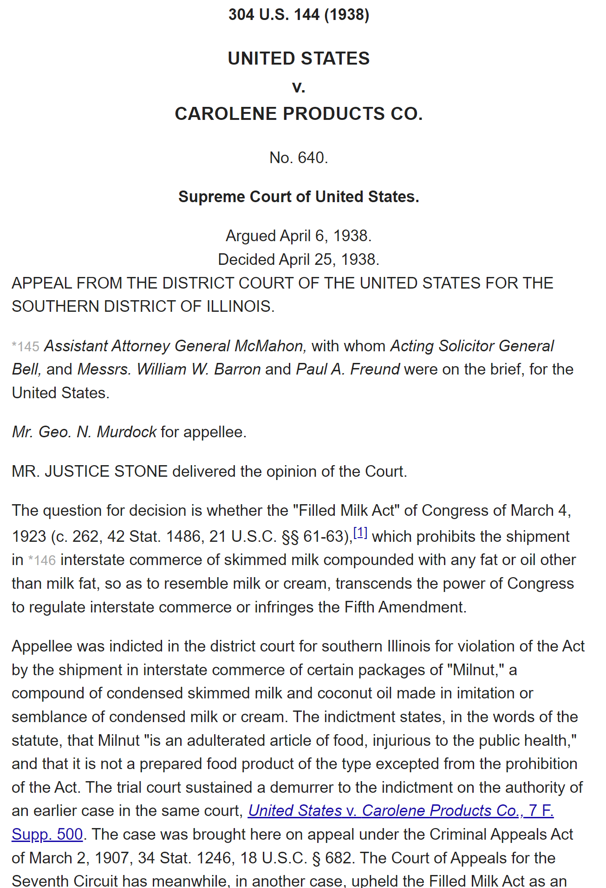

Slide 13
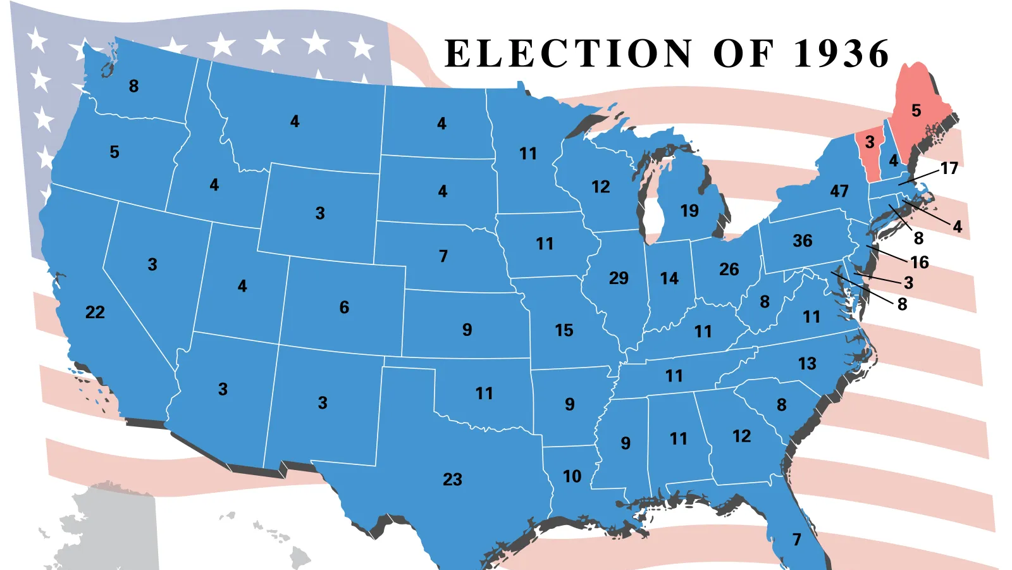

Slide 14
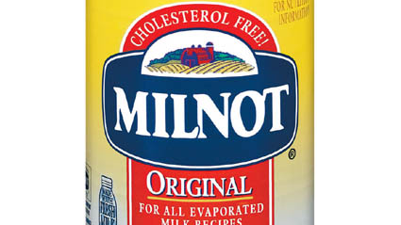

Slide 17
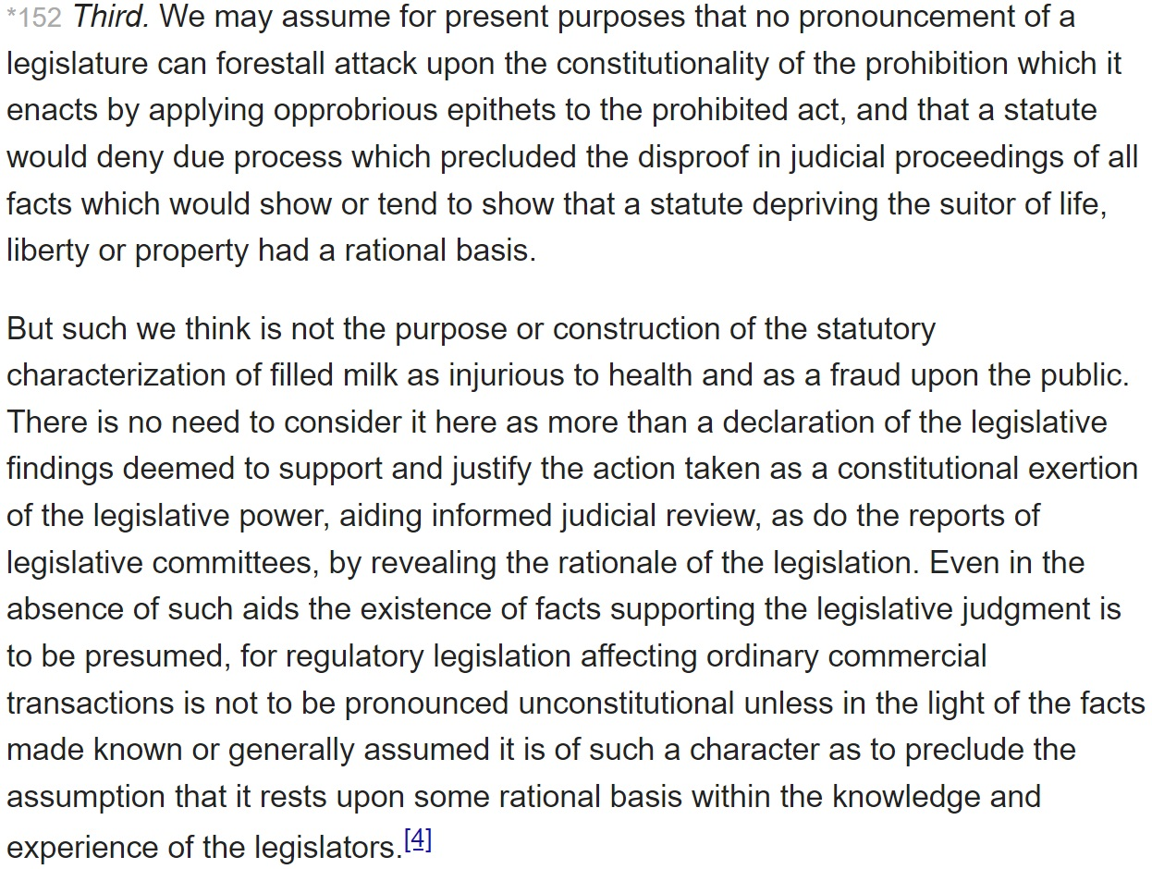

Slide 19
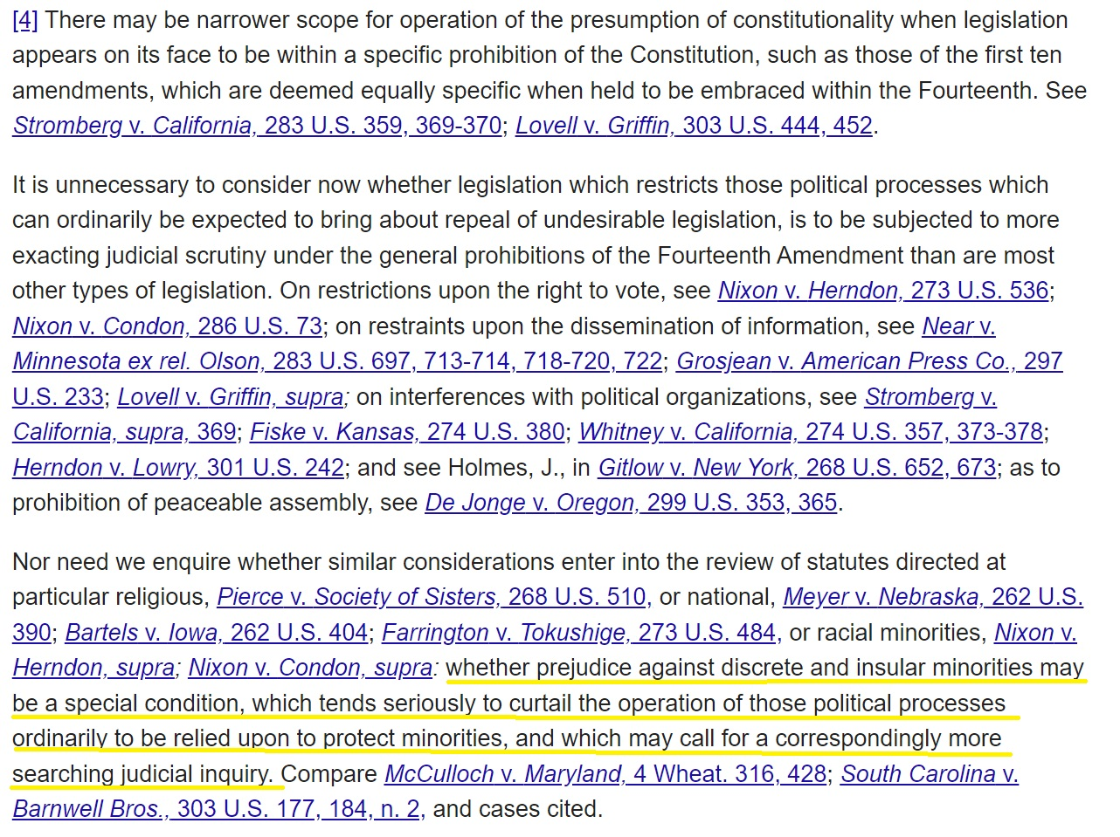

Slide 20
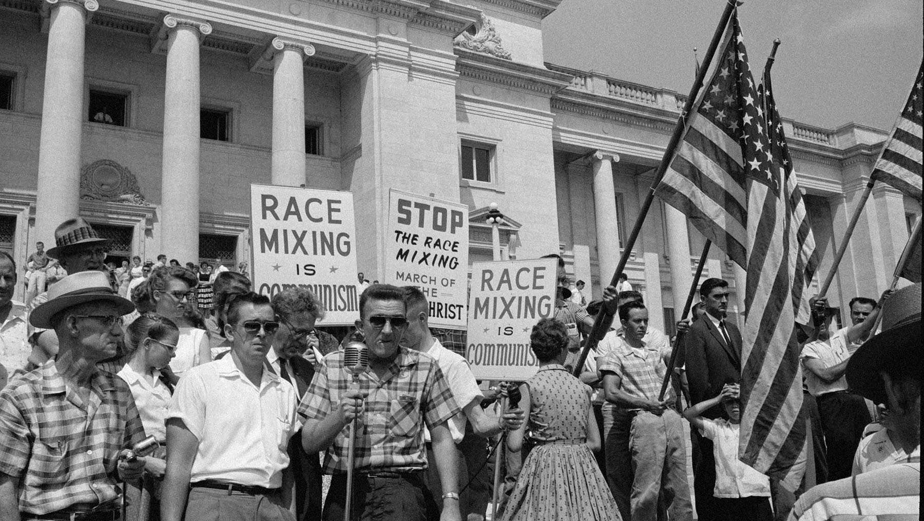
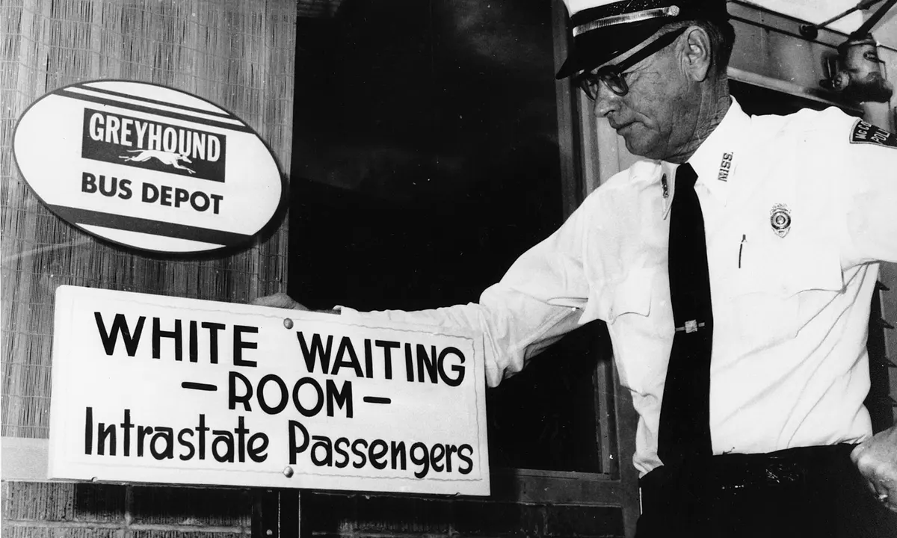
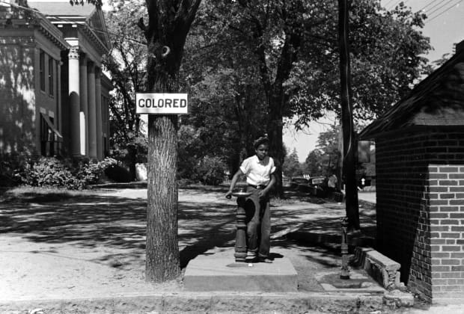
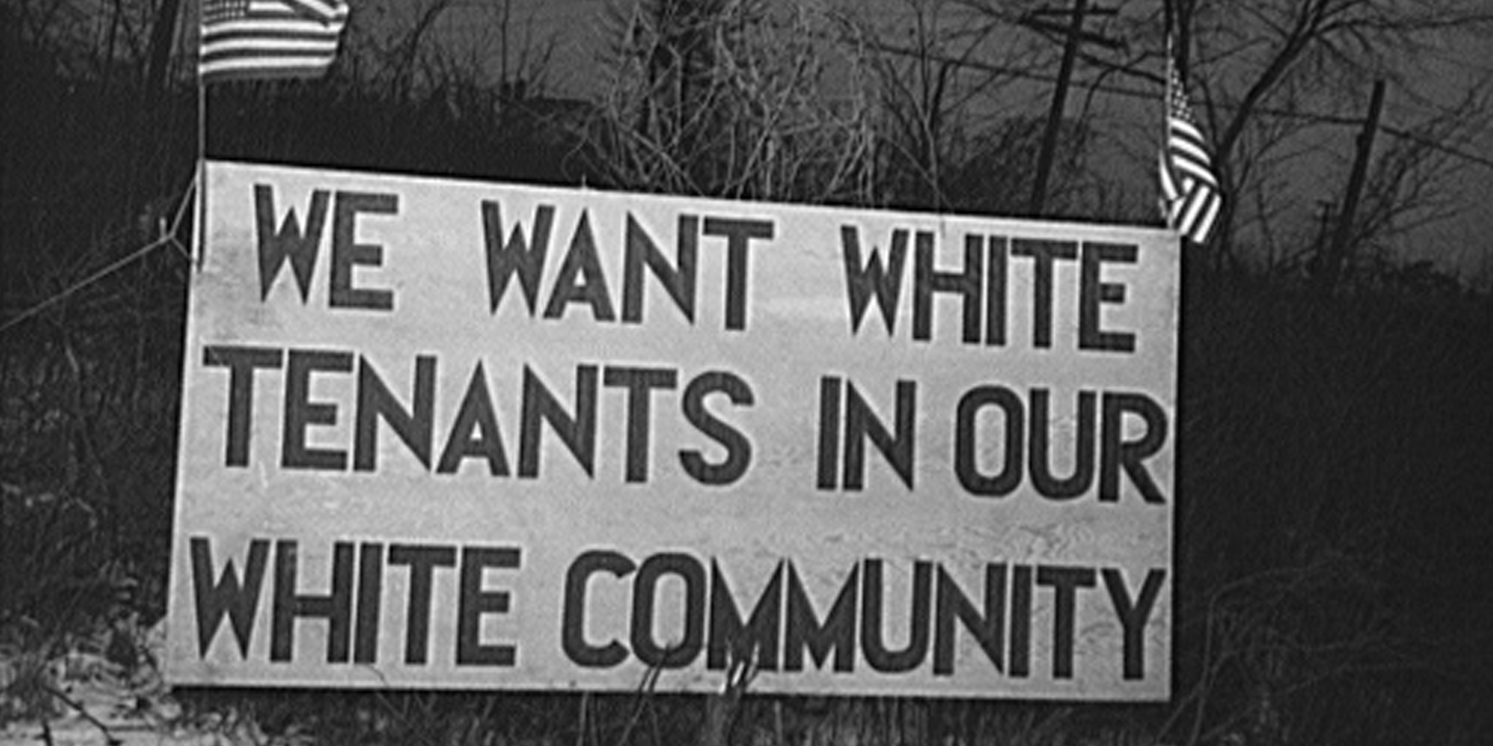
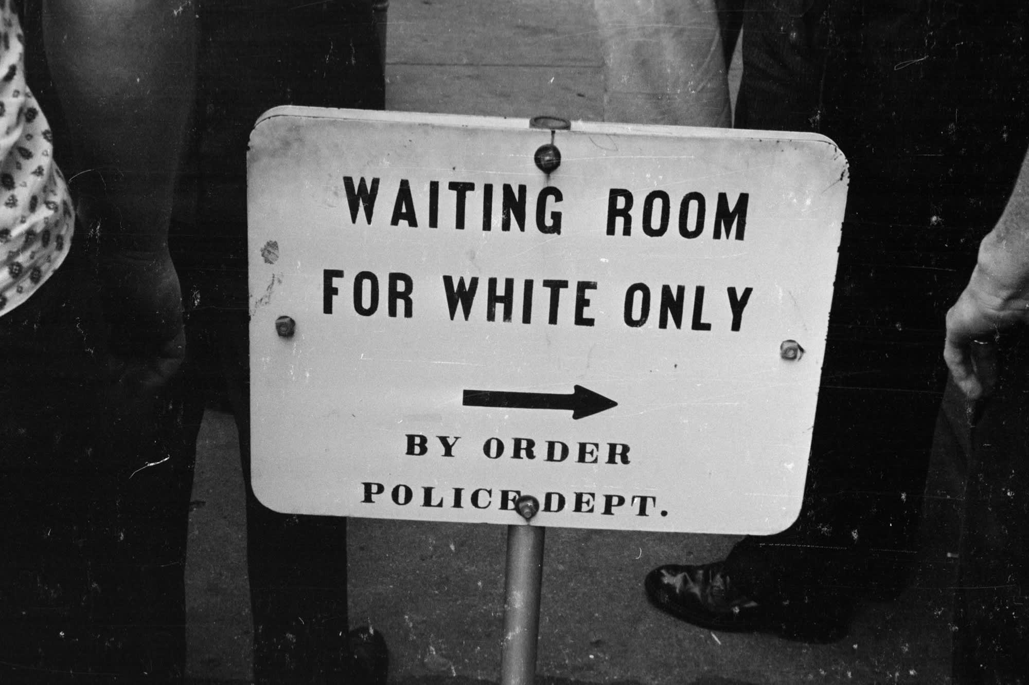
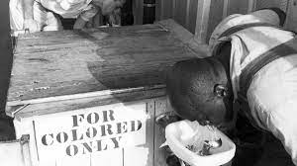

Slide 21
The valuable improvements made by the American constitutions on the popular models, both ancient and modern, cannot certainly be too much admired; but it would be an unwarrantable partiality, to contend that they have as effectually obviated the danger on this side, as was wished and expected. Complaints are everywhere heard from our most considerate and virtuous citizens, equally the friends of public and private faith, and of public and personal liberty, that our governments are too unstable, that the public good is disregarded in the conflicts of rival parties, and that measures are too often decided, not according to the rules of justice and the rights of the minor party, but by the superior force of an interested and overbearing majority.
-James Madison, Federalist No. 10 (1787)

Slide 22
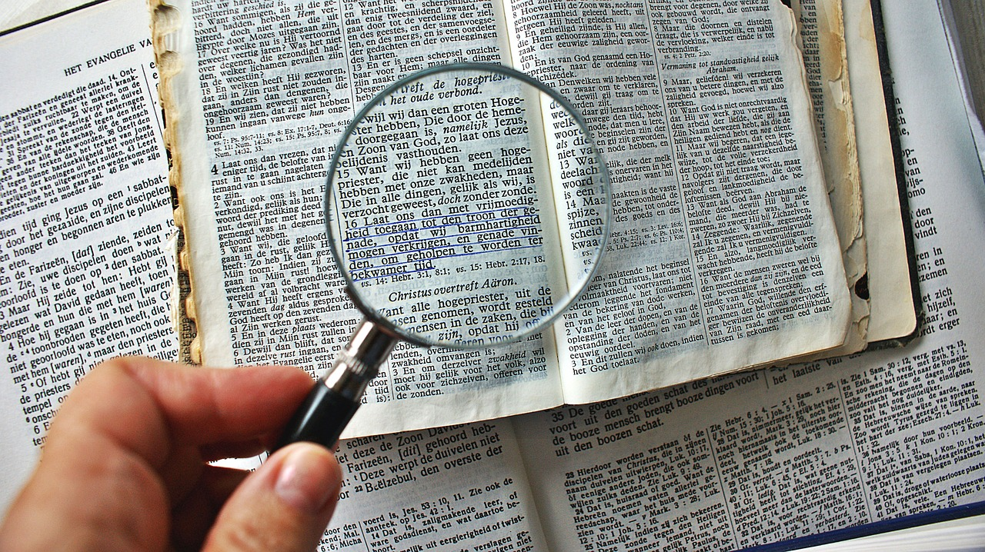
PART II

Slide 24
“Where does it say ‘abortion’ in the Constitution?”

Slide 25
“Where does it say ‘dating’ in the Constitution?”

Slide 26
“Where does it say ‘marriage’ in the Constitution?”

Slide 27
“Where does it say ‘condoms’ in the Constitution?”

Slide 28
“Where does it say ‘clothes’ in the Constitution?”

Slide 29
“Where does it say ‘hair color’ in the Constitution?”

Slide 30
“Where does it say ‘adult toys’ in the Constitution?”

Slide 31
“Where does it say ‘butt stuff’ in the Constitution?”

Slide 32
5th Amendment: “No person shall … be deprived of life, liberty, or property without due process of law….” 14th Amendment: “No State shall … deprive any person of life, liberty, or property without due process of law….”

Slide 33
5th Amendment: “No person shall … be deprived of life, liberty, or property without due process of law….” 14th Amendment: “No State shall … deprive any person of life, liberty, or property without due process of law….”

Slide 34
[T]he "liberty" protected by the Fifth and Fourteenth Amendments from infringement by the Federal Government or the States is not restricted to rights specifically mentioned in the first eight amendments. Cf. United Public Workers v. Mitchell, 330 U. S. 75, 94-95. In determining which rights are fundamental, judges are not left at large to decide cases in light of their personal and private notions. Rather, they must look to the "traditions and [collective] conscience of our people" to determine whether a principle is "so rooted [there] . . . as to be ranked as fundamental.” Snyder v. Massachusetts, 291 U. S. 97, 105. The inquiry is whether a right involved "is of such a character that it cannot be denied without violating those `fundamental principles of liberty and justice which lie at the base of all our civil and political institutions….’” Powell v. Alabama, 287 U. S. 45, 67.

Slide 35
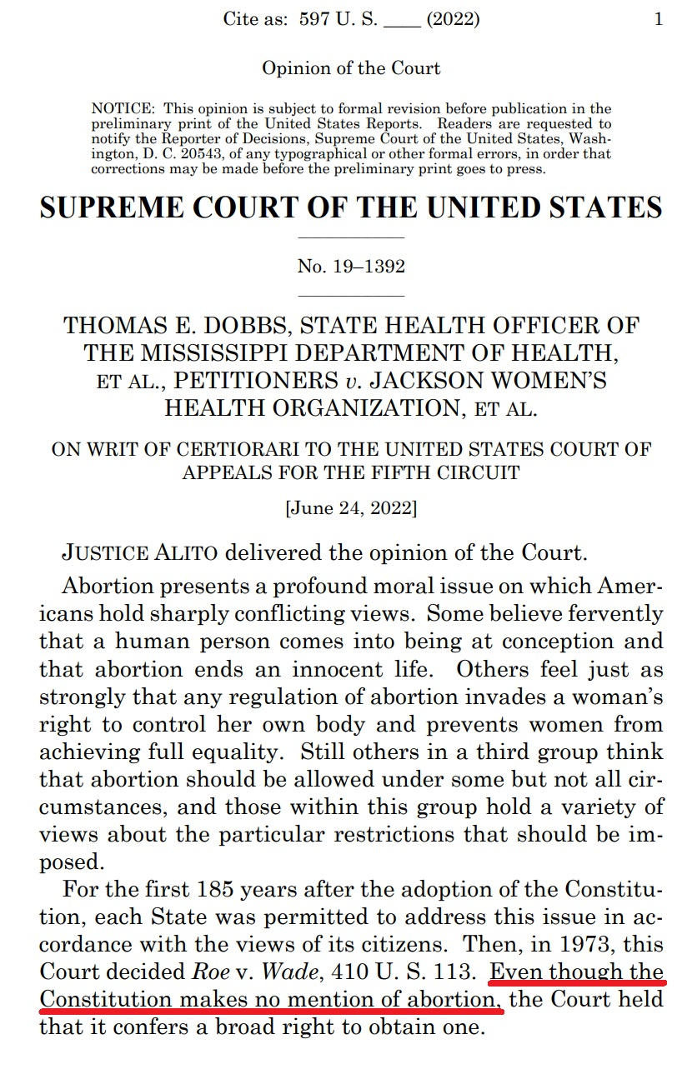
“Even though the Constitution makes no mention of abortion…..” (p. 1)

Slide 36
“Even though the Constitution makes no mention of abortion…..” (p. 1)
“It held that the abortion right, which is not mentioned in the Constitution, is part of a right to privacy, which is also not mentioned.” (p. 9)
“That is why the Court has long been ‘reluctant’ to recognize rights that are not mentioned in the Constitution.” (p. 14)
“[T]hat argument flies in the face of the standard we have applied in determining whether an asserted right that is nowhere mentioned in the Constitution is nevertheless protected by the Fourteenth Amendment.” (p. 25)
“As we have explained, procuring an abortion is not a fundamental constitutional right because such a right has no basis in the Constitution’s text or in our Nation’s history.” (p. 77)

Slide 37
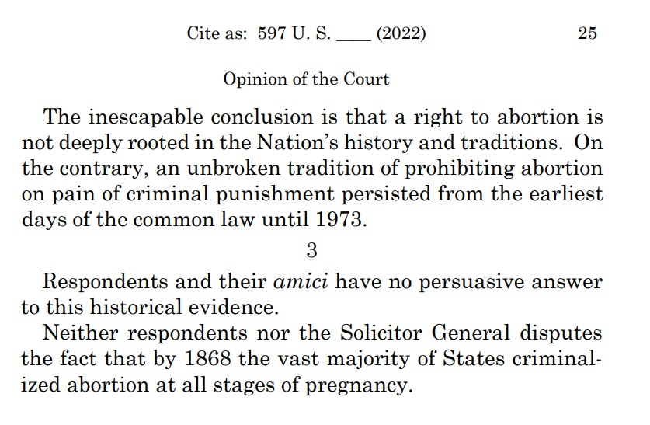

Slide 38
1. By requiring a right to be “deeply rooted in our nation’s history and traditions” to count as “implicit in the concept of ordered liberty,” it means that by definition ONLY THOSE WHO DO NOT NEED THE CONSTITUTION’S PROTECTION can possibly get it.

Slide 39
1. By requiring a right to be “deeply rooted in our nation’s history and traditions” to count as “implicit in the concept of ordered liberty,” it means that by definition ONLY THOSE WHO DO NOT NEED THE CONSTITUTION’S PROTECTION can possibly get it.
2. Deeply-rooted “traditions” means traditions at the time the 5th and 14th Amendments were ratified (1791 and 1868). This means, in no uncertain terms, that only the traditions of white, male, cisgendered, heterosexual, landed property owners count. This means that the traditions of slave owners count in defining “liberty” but the traditions of slaves do not.

Slide 41
PART III
?

Slide 43
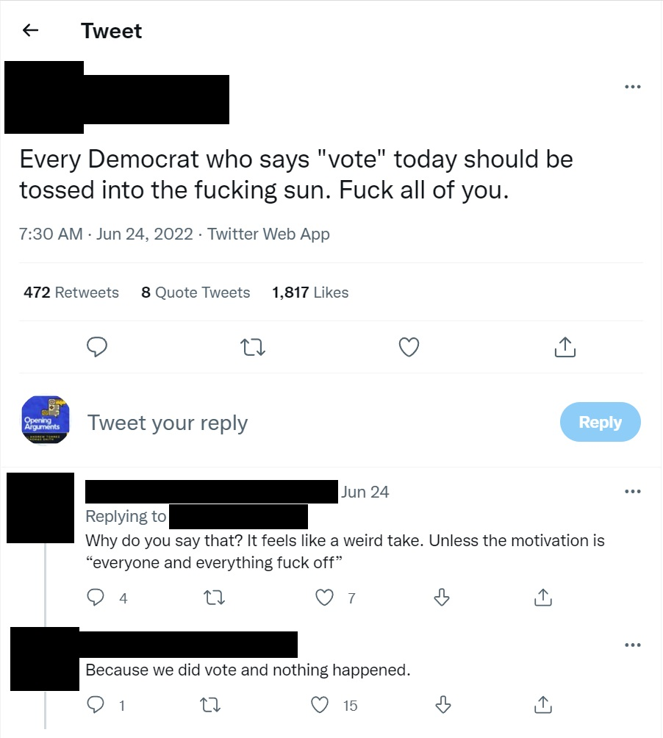

Slide 44
Michigan: 51,463 votes for Stein Trump won by 10,704 votes
Wisconsin: 31,072 votes for Stein Trump won by 22,748 votes
Pennsylvania: 49,941 votes for Stein Trump won by 44,292 votes

Slide 45
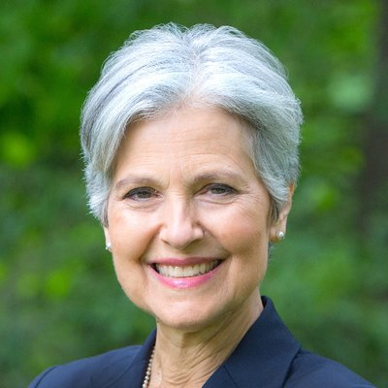
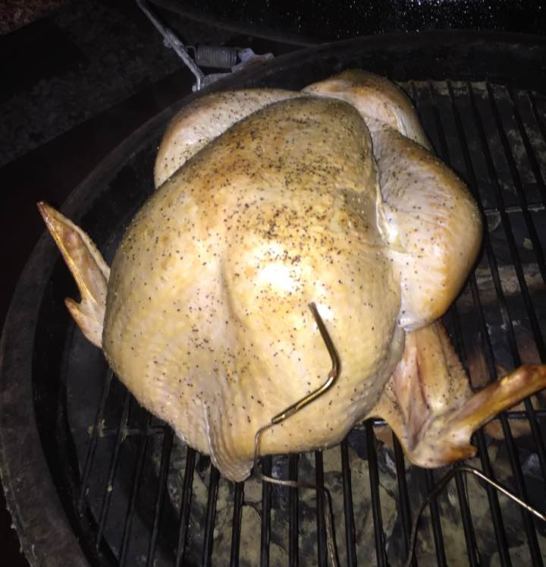

Slide 46
Michigan: 51,463 votes for Stein Trump won by 10,704 votes
Wisconsin: 31,072 votes for Stein Trump won by 22,748 votes
Pennsylvania: 49,941 votes for Stein Trump won by 44,292 votes

Slide 47
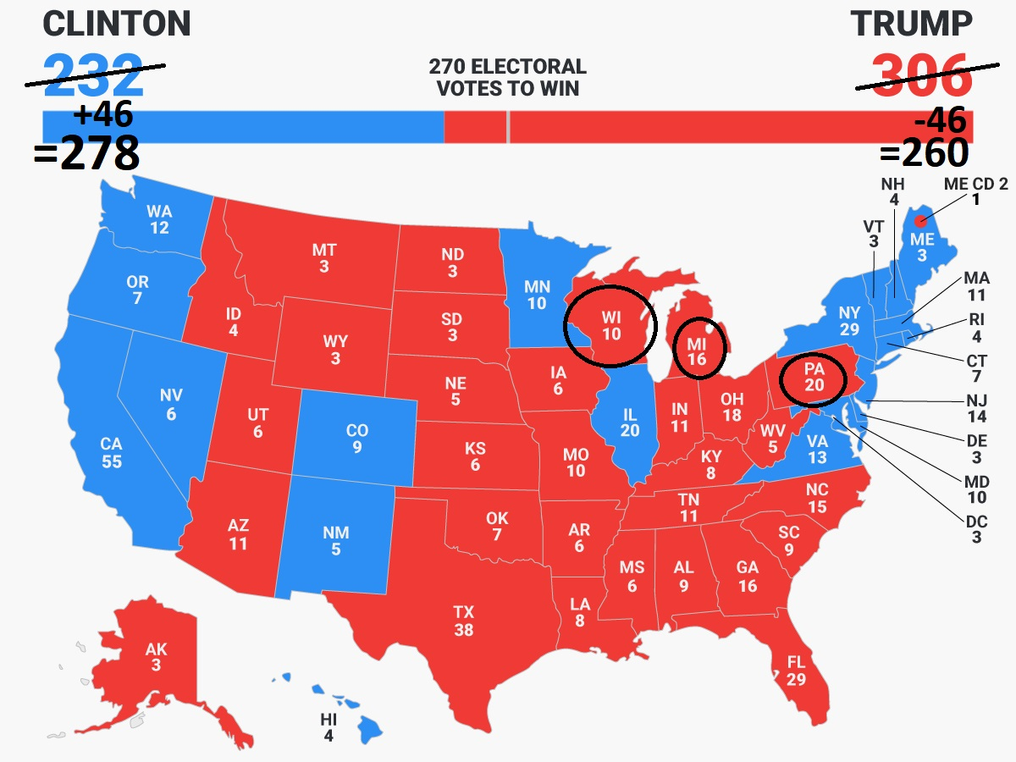

Slide 48
Michigan: 51,463 votes for Stein Trump won by 10,704 votes
Wisconsin: 31,072 votes for Stein Trump won by 22,748 votes
Pennsylvania: 49,941 votes for Stein Trump won by 44,292 votes

Slide 49
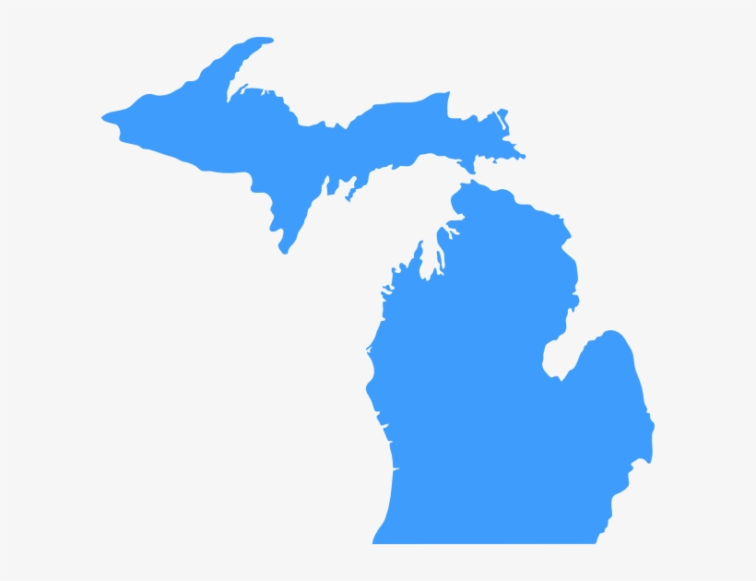
1992
1996
2000
2004
2008
1988
2012
2008
1992
1996
2000
2004
2012

Slide 50
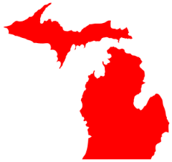
1992
1996
2000
2004
2016
2008
1988
2012
2008
2016
1992
1996
2000
2004
2012

Slide 51
New Hampshire: 22,198 votes for Nader
Bush won by 7,211 votes

Slide 52
Your vote* is not a message.
* - Your vote in the general election, in states with first-past-the-post voting rules and no instant runoffs, is not a message.

Slide 53
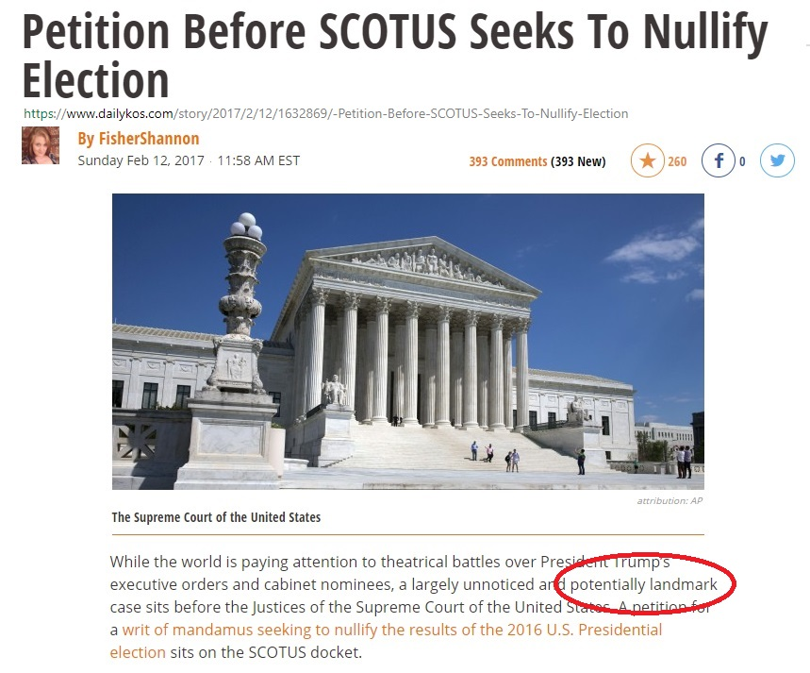

Slide 54
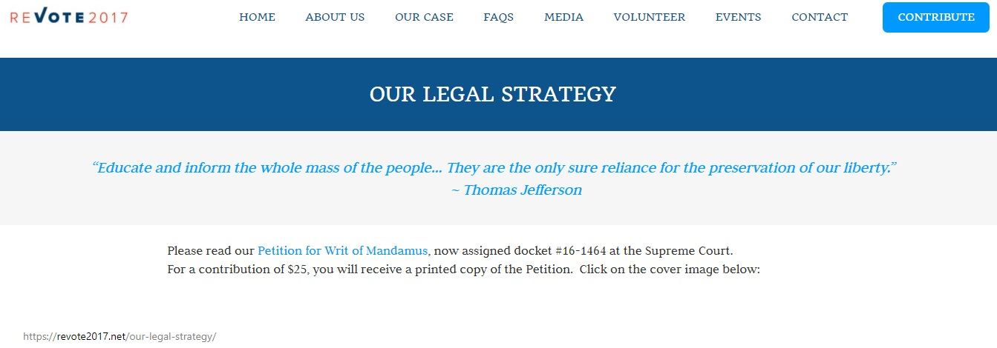

Slide 56
The Supreme Court has abandoned its most important historical justification: to protect discrete and insular minorities from majority legislation.

Slide 57
The Supreme Court has abandoned its most important historical justification: to protect discrete and insular minorities from majority legislation.
The Supreme Court has replaced this century-old test with a new one they just made up that explicitly cares only about the historical views of white, male, cisgendered, heterosexual, landed property owners.

Slide 58
The Supreme Court has abandoned its most important historical justification: to protect discrete and insular minorities from majority legislation.
The Supreme Court has replaced this century-old test with a new one they just made up that explicitly cares only about the historical views of white, male, cisgendered, heterosexual, landed property owners.
The last time they did this, the Supreme Court kept at it for FORTY YEARS until we mustered overwhelming electoral force. We’re in year five. This is a long fight.

Slide 59
The Supreme Court has abandoned its most important historical justification: to protect discrete and insular minorities from majority legislation.
The Supreme Court has replaced this century-old test with a new one they just made up that explicitly cares only about the historical views of white, male, cisgendered, heterosexual, landed property owners.
The last time they did this, the Supreme Court kept at it for FORTY YEARS until we mustered overwhelming electoral force. We’re in year five. This is a long fight.
That fight will be longer if you give up, drop out, or vote third party.

Slide 60
The Supreme Court Hates You (Yes You!) Personally & What (Little) You Can Do About It
www.patorrez.com

